Slide 1
British Airways
Customer ratings analysis and insights
Praful Samadhan Mane
2023-07-07

Slide 2
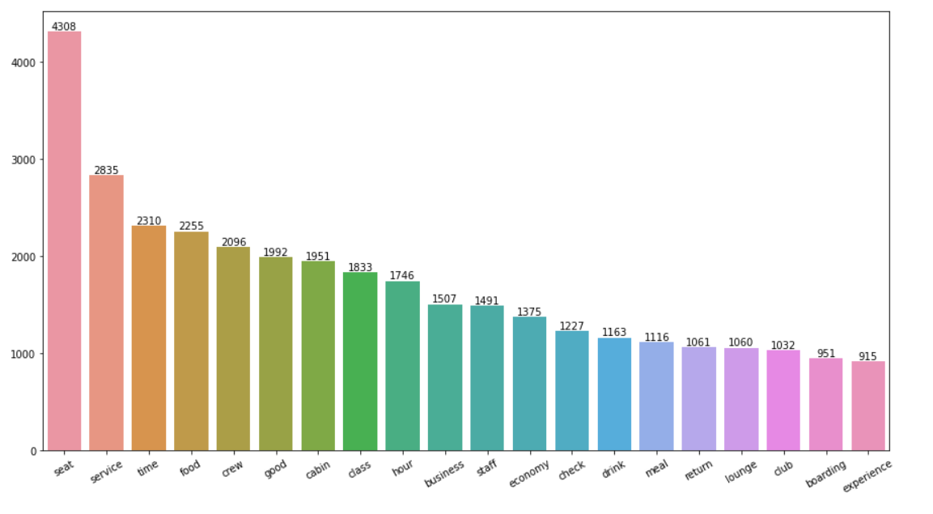
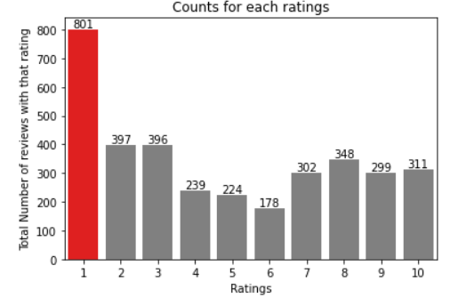
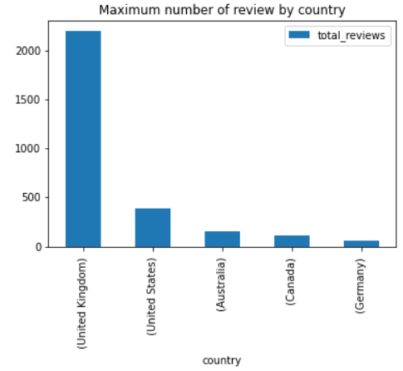

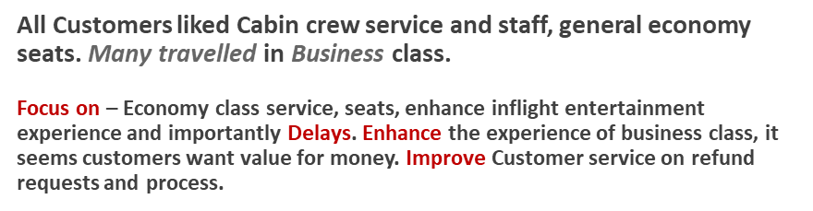
Key metrics
Average Overall Rating
4.75 /10
Reviews from 70 Countries
3495 Total reviews
collected
What customers are happy and unsatisfied about for different ratings class:
7-10 ratings wrote about comfortable seats, good inflight entertainment, descent food quality.
4-6 ratings faced problem with small entertainment screen, long passport check queue, bad business class experience.
1-3 ratings wrote dissatisfaction on congested middle seat and small screen while they liked the seats and the food.

